Slide 1
Using Artificial Neural Network (ANN) to predict Oil & Gas Recovery Factor
Student Name: Ho Kai Toong
PI Number: Q2081581
Supervisor Name: Dr Munish Kumar

Slide 2


1. Business Understanding
Predicting Oil & Gas (O&G) Recovery Factor (RF) in Oil Reservoirs
Reasons
RF = Proportion of Available O&G Extraction / Total Volume of Hydrocarbons
The measurement of RF is by %
Directly reflects how much of the hydrocarbons can be economically recovered
Accurate prediction of RF can help O&G Businesses to discover factors that lead to high RF
Higher RF = Higher Efficiency of Oil production = Higher Return on Investment
Challenges
Complex Nature of Oil Reservoirs (Different reservoirs contain diverse variables)
The heterogeneity of oil reservoirs can create unpredictable trends = Difficult to predict the RF
In early life, O&G operators rely on their field experiences for the prediction of RF
Predicting RF requires effective predictive modelling to tackle this complexity

Slide 3
1. Business Understanding
Application of ANN
Discover complex, nonlinear, and multi-dimensional functional relationships between the inputs and output
Predicting RF is a regression task; ANN can predict a continuous output
Project Objective
Examine if ANN can predict RF on the dataset
Compare two platforms: IBM SPSS Modeler or Python to study which is a better platform for the prediction
Compare optimized ANN results with Dr Kumar’s paper results to analyze which is a better system in predicting RF on the same dataset
Literature Reviews show a common theme that ANN is the one of the best performing models in predicting RF
Predict Ultimate Recovery Factor (URF) of Oil Reservoirs in Gulf of Mexico (Gowtham & Wu, 2017)
Predict Oil Recovery Factor (ORF) for Water Drive Sandy Reservoirs (Ahmed et al., 2019)
Predict Movable ORF of a Layered Reservoir (Shams et al., 2020)

Slide 4
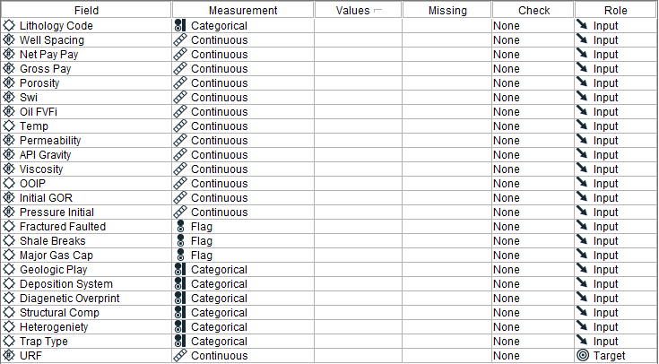
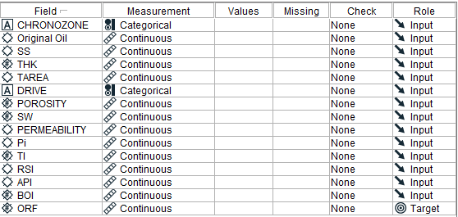
2. Data Understanding
Exploration of the Two Given Datasets
Tertiary Oil Recovery Information System (TORIS) database
A reservoir database consisting of around 2,500 U.S crude oil fields
23 Inputs: 10 Categorical and 13 Continuous Variables
A Continuous Output: “URF”
Number of Records: 449
Gulf of Meixco (GOM) database
A database collated by Bureau of Ocean Energy Management
14 Inputs: 2 Categorical and 12 Continuous Variables
A Continuous Output : “ORF”
Number of Records: 4,512

Slide 5
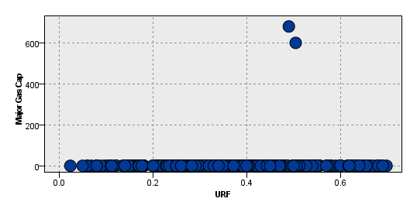
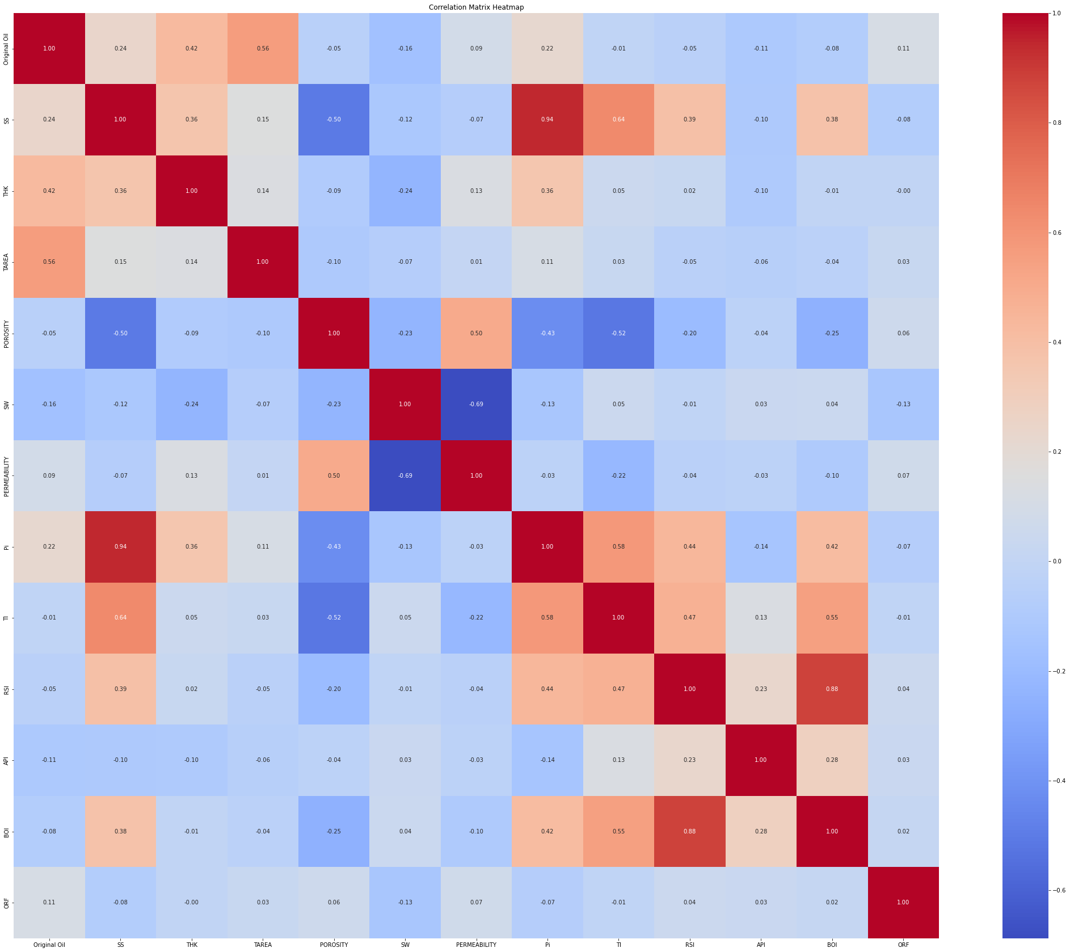
2. Data Understanding
Exploration of the Two Given Datasets
Check for Missing Values
Check for Incorrect Inputs/Outliers
Check for Multicollinearity
Dataset | Missing Value
TORIS | Nil
GOM | Nil
Pearson Correlation > 0.7
0.94 for Pi and SS
0.88 for BOI and RSI

Slide 6
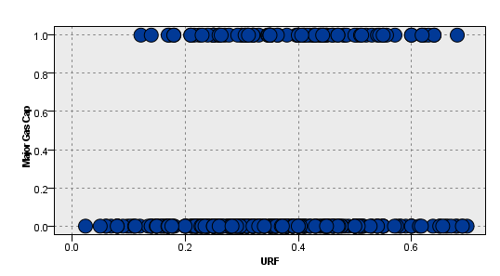
3. Data Preparation
Data Cleaning Process
Remove Incorrect Inputs/Outliers
Normalize Numerical Features
Apply One-hot/Label Encoding on Categorical Variables
Z-score Normalization
Temp Before | Temp After
146 | 0.209
190 | 1.260
169 | 0.758
Label Encoding
DRIVE Before | DRIVE After
WTR | 1
UNK | 2
SLG | 3

Slide 7
4. Modelling
Generate Test Design
Evaluation Methods Suitable for Regression Task
Mean Absolute Error (MAE)
Average Absolute Difference between the predicted and actual values
Lower the MAE = Prediction values closer to actual values
Coefficient of determination (R²)
Goodness of fit of the model
Higher the R² = Model fits the data better
Dataset | Partition
 | Training Set | Validation Set | Testing Set
TORIS (400+ Records) | 70 | 10 | 20
GOM (4,000+ Records) | 80 | 10 | 10

Slide 8
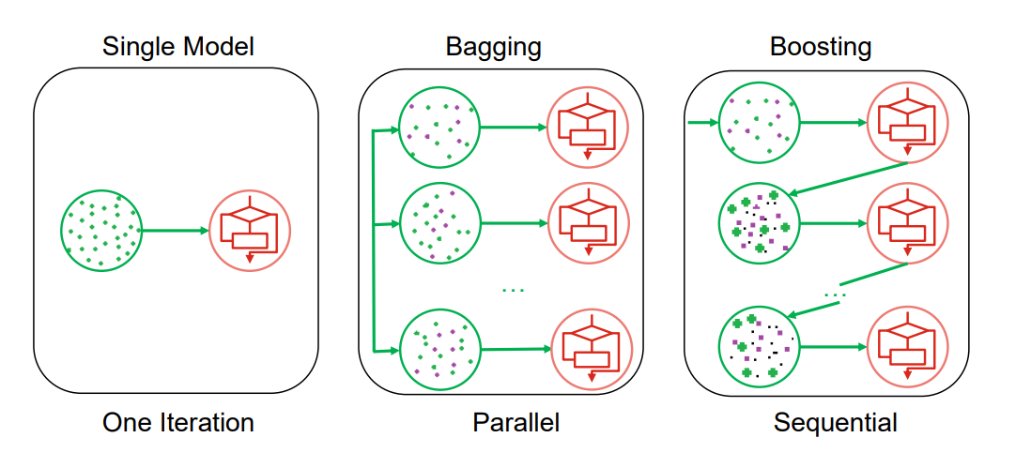
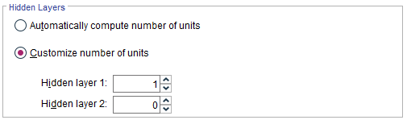
4. Modelling – IBM SPSS Modeler
Build and Assess Model
Single ANN
Train a single model
ANN with Bagging (Bootstrapping)
Ensemble technique to improve the stability of the model
ANN with Boosting
Another ensemble technique which focuses on improving the accuracy of the model
Basic Hyperparameters to Tune
Number of Hidden Layers and Neurons

Slide 9
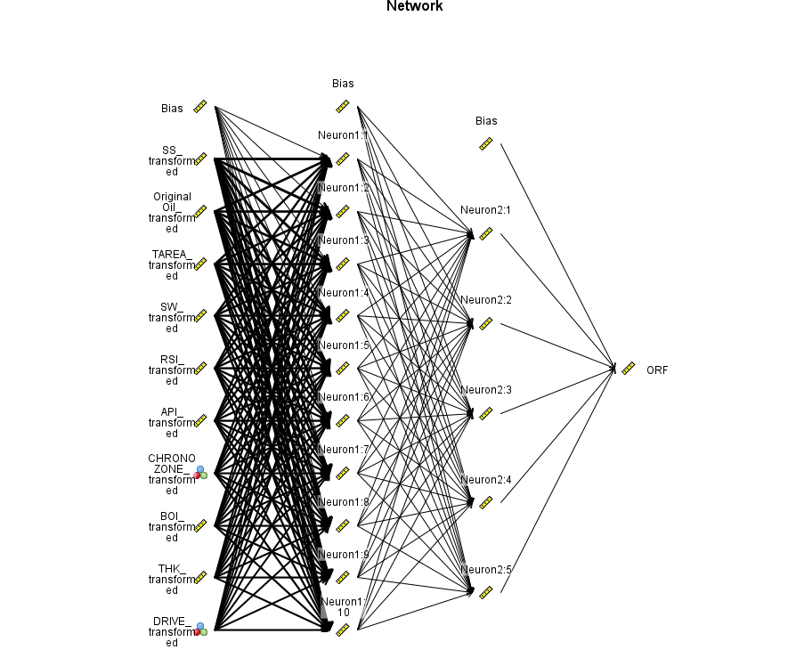
4. Modelling – IBM SPSS Modeler
Build and Assess Model
IBM SPSS Modeler automatically selects the 10 most important features during the model construction
Tuning of Hyperparameters is limited
Basic Hyperparameters: Number of hidden layers (max 2) and neurons
Stopping Rules: Number of training cycles
Blackbox-Approach
Unknown activation functions are used in hidden and output layers
Dataset | Optimized Solution
 | Number of Hidden layers | Number of Neurons
TORIS | 1 | 1
GOM | 2 | 10, 5

Slide 10
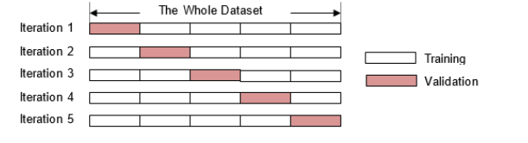
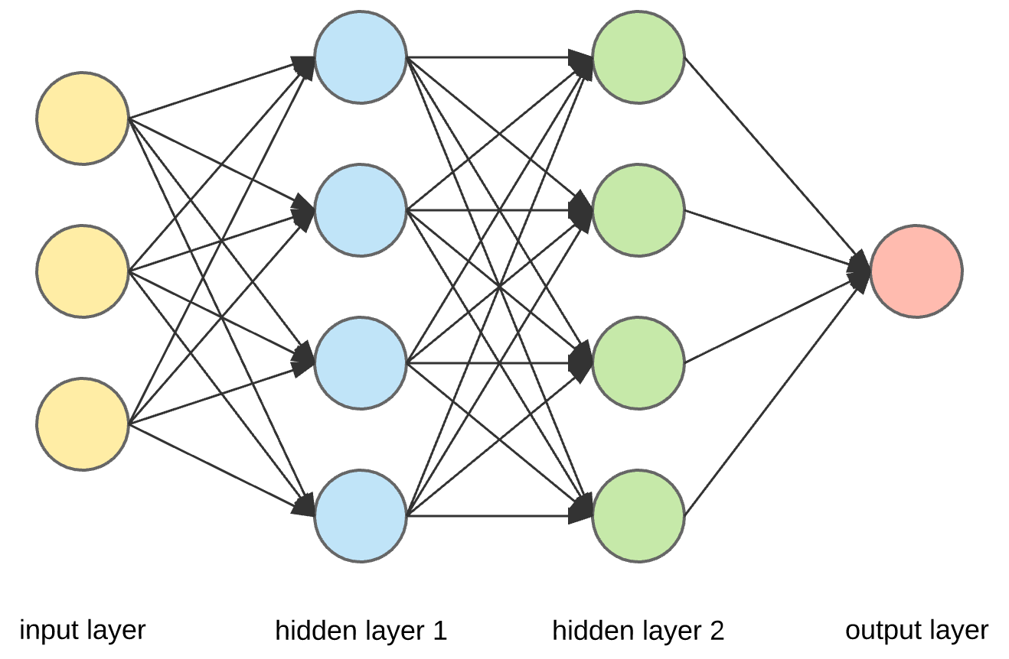
4. Modelling – Python
Build and Assess Model
Single ANN
ANN with K-Fold Cross-Validation (Suitable for small dataset)
Hyperparameters to Tune
Number of Hidden Layers and Neurons
Epoch and Batch Size
Learning Rate
Drop-out Rate
Optimizer
Activation Function

Slide 11
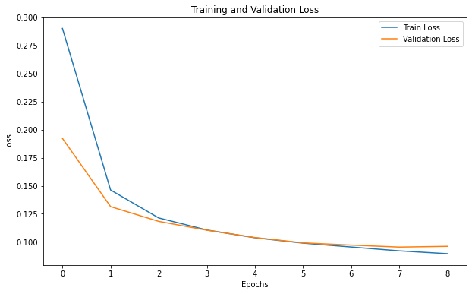
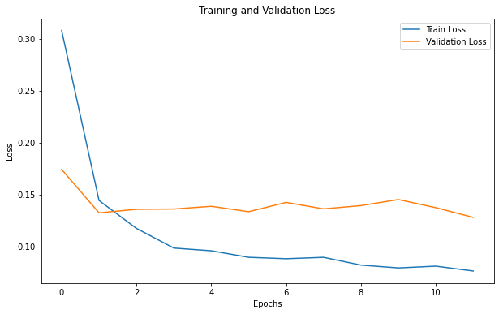
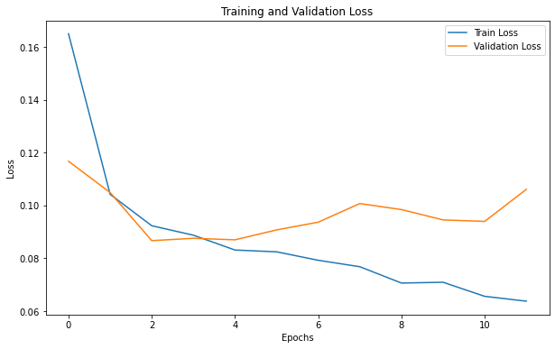
4. Modelling – Python
Build and Assess Model
Increasing number of hidden layers & neurons lead to overfitting
Increase the learning rate leads to more instability of the model
TORIS – Single ANN
Hidden Layer = 1, Neurons = 3, Learning rate = 0.001
Hidden Layer = 2, Neurons = 5, 2, Learning rate = 0.002
Hidden Layer = 3, Neurons = 10, 5, 3, Learning rate = 0.003

Slide 12
4. Modelling – Python
Build and Assess Model
TORIS
GOM
Hyperparameters | Optimized Solution
Input Variables Used | All
Number of Hidden Layers and Neurons | 1 (3 Neurons)
Epoch | 9
Batch Size | 5
Optimizer | Adam
Activation Functions | Relu (Hidden Layer) and Linear (Output Layer)
Hyperparameters | Optimized Solution
Input Variables Used | All except CHRONOZONE, BOI, Pi
Number of Hidden Layers and Neurons | 2 (20 & 10 Neurons)
Epoch | 40
Batch Size | 5
Optimizer | Adam
Activation Functions | Relu (Hidden Layer) and Tanh (Output Layer)

Slide 13
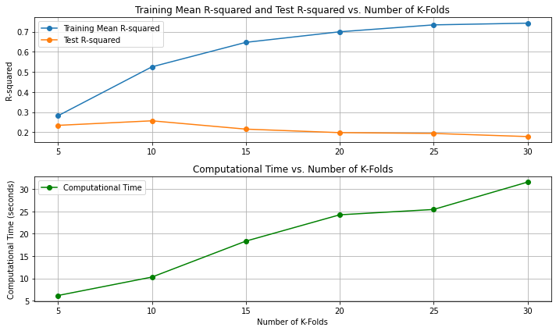
4. Modelling – Python
Build and Assess Model
TORIS – ANN with K-Fold Cross-Validation
Increasing K-Fold leads to overfitting
Increasing K-Fold increases computational time
Dataset | Optimized K-Fold Value
TORIS | 5
GOM | 9

Slide 14
5. Evaluation
Results Comparison of All ANN Models
IBM SPSS Modeler | TORIS |  |  |  | GOM
 | Training MAE | Testing MAE | Training R² | Testing R² | Training MAE | Testing MAE | Training R² | Testing R²
Single ANN Model | 0.094 | 0.102 | 0.21 | 0.09 | 0.120 | 0.125 | 0.19 | 0.16
ANN Model with Boosting | 0.020 | 0.111 | 0.92 | 0.03 | 0.110 | 0.111 | 0.35 | 0.40
ANN Model with Bagging | 0.055 | 0.106 | 0.71 | 0.06 | 0.106 | 0.111 | 0.39 | 0.37
Python | TORIS |  |  |  | GOM
 | Training MAE | Testing MAE | Training R² | Testing R² | Training MAE | Testing MAE | Training R² | Testing R²
Single ANN Model | 0.087 | 0.089 | 0.26 | 0.34 | 0.097 | 0.098 | 0.45 | 0.41
ANN Model with K-Fold Cross-Validation | 0.084 | 0.124 | 0.28 | 0.23 | 0.092 | 0.080 | 0.47 | 0.55
Constructed ANN models on Python outperforms the ones on IBM SPSS Modeler; Higher R²
Comparing only the single ANN models between IBM SPSS Modeler and Python, there are significant improvements on Python
More hyperparameters to tune on Python

Slide 15
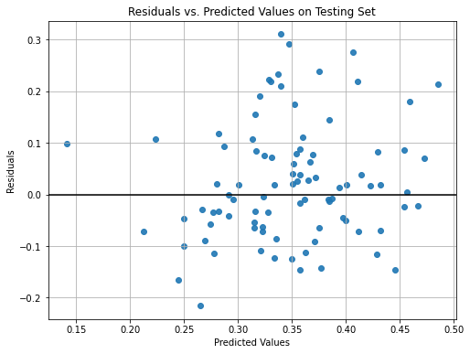
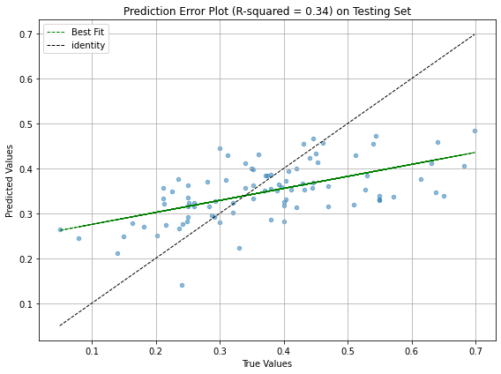
5. Evaluation
Results of Optimized ANN Model
TORIS
The ANN model performs poorly on the dataset
The ANN model can only explain 34% of the variability of the data

Slide 16
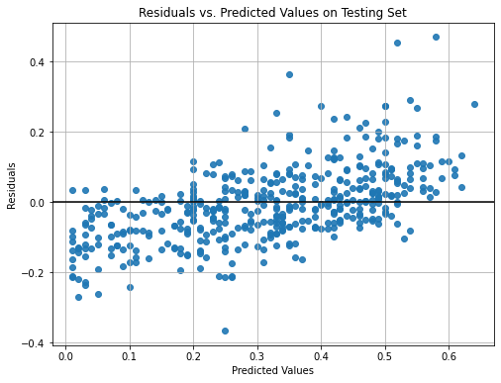
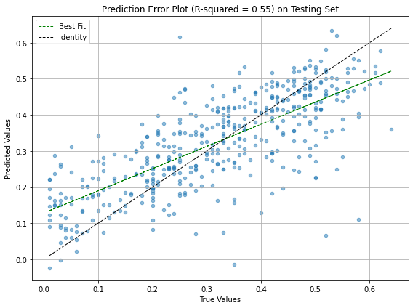
5. Evaluation
Results of Optimized ANN Model
GOM
The ANN model performs moderately on the dataset
The ANN model explains 55% of the variability of the data

Slide 17
5. Evaluation
Results Comparison between Optimized ANN Model and Other Predictive Models
Database | R² on Testing Set
 | ANN | Other Models
TORIS | 0.34 | 0.81
GOM | 0.55 | 0.88
ANN performs worse compared to other models
Conclusion
Interestingly, unlike the literature reviews, the results suggest a contrasting view where ANN performs poorly in predicting the RF
Subjected to different dataset, different platform, different model architecture = different results
ANN performance on Python is better than the ones on IBM SPSS Modeler
More options for hyperparameters tuning on Python
For this dataset, deep learning networks like ANN may not be suitable to predict the RF; Less complex models may be more suitable
Other Models (Kumar et al., 2022)
TORIS – 0.81 is the Average R² of Decision Trees with Blended, Bagged KNN, Random Forest, Bagged Catboost
GOM – 0.88 is the Average R² of Decision Trees with Catboost, Bagged Catboost, Random Forest, stack

Slide 18
References
Ahmed, A. A., Salaheldin, E., Chen, W., & Abdulazeez, A. (2019). Estimation of oil recovery factor for water drive sandy reservoirs through applications of artificial intelligence. Energies.
Gowtham, T., & Wu, X. (2017). Using data analytics on dimensionless numbers to predict the ultimate recovery factors for different drive mechanisms of Gulf of Mexico oil fields.
Kumar, M., Swaminathan, K., Rusli, A., & Thomas-Hy, A. (2022). Applying data analytics & machine learning methods for recovery factor prediction and uncertainty modelling.
Shams, K., Sidqi, A. A., Hasan, Y. A., & Rahul, G. (2020). A novel empirical correlation for waterflooding performance prediction in stratified reservoirs using artificial intelligence. Neural Computing and Applications.

Slide 19

Question & Answer

